Slide 1
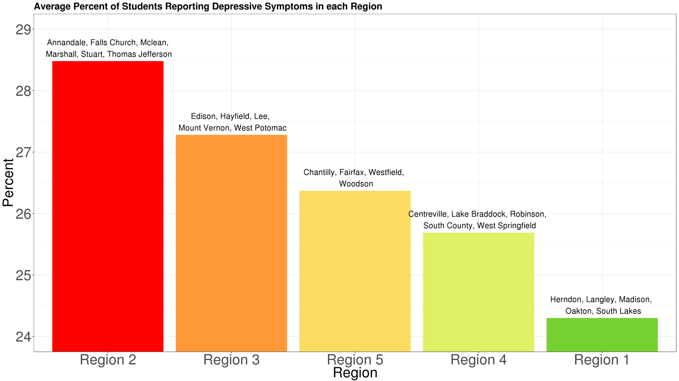
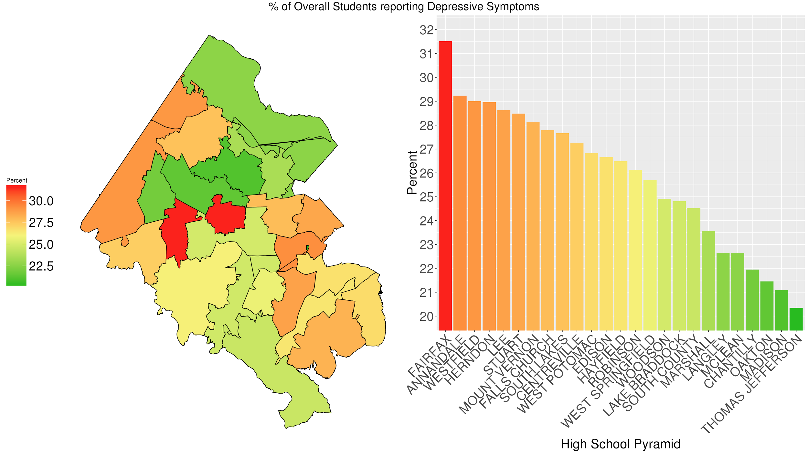
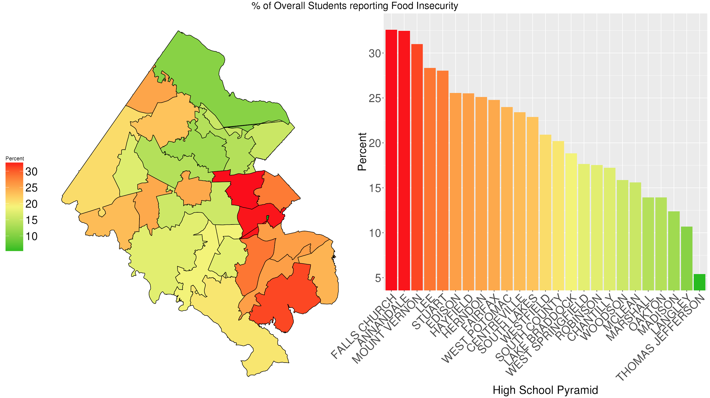
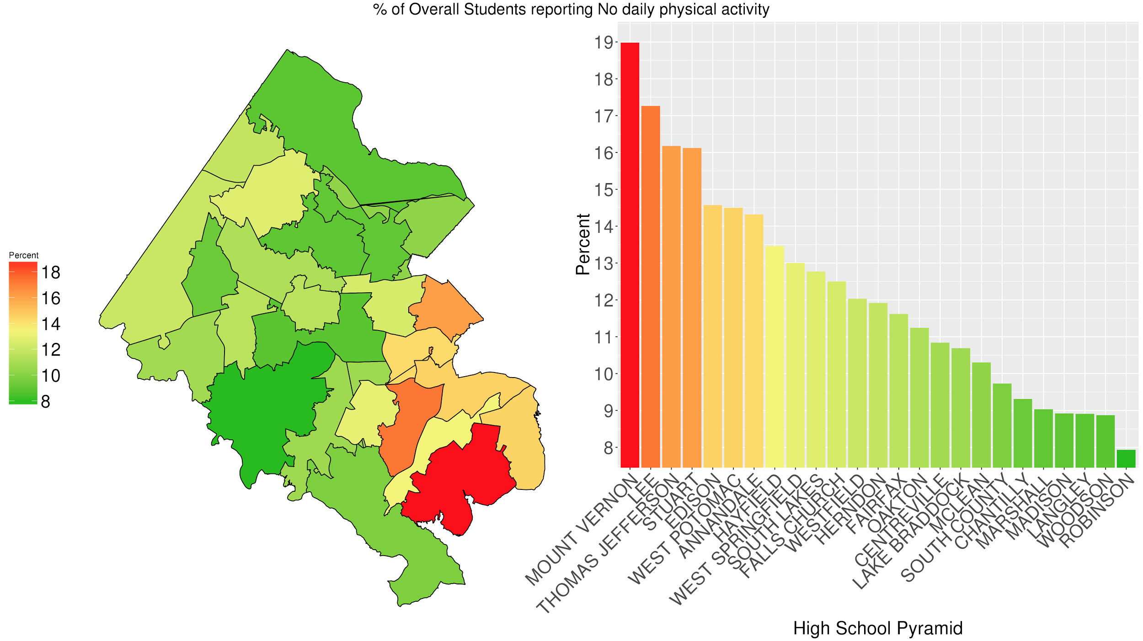
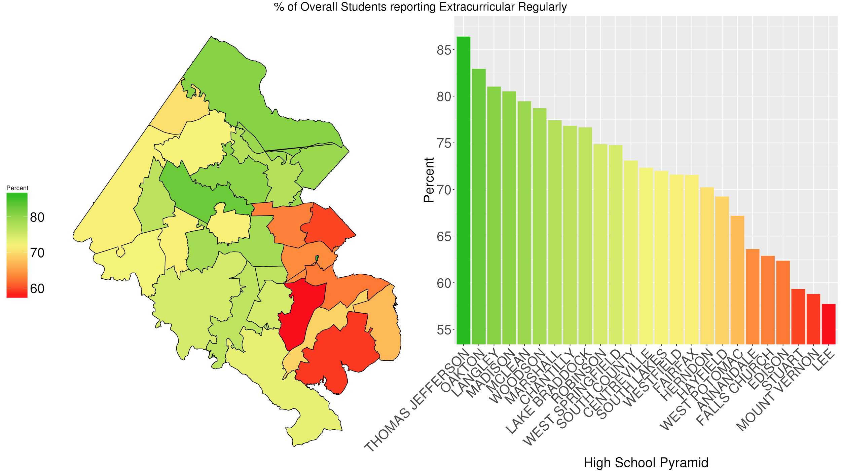
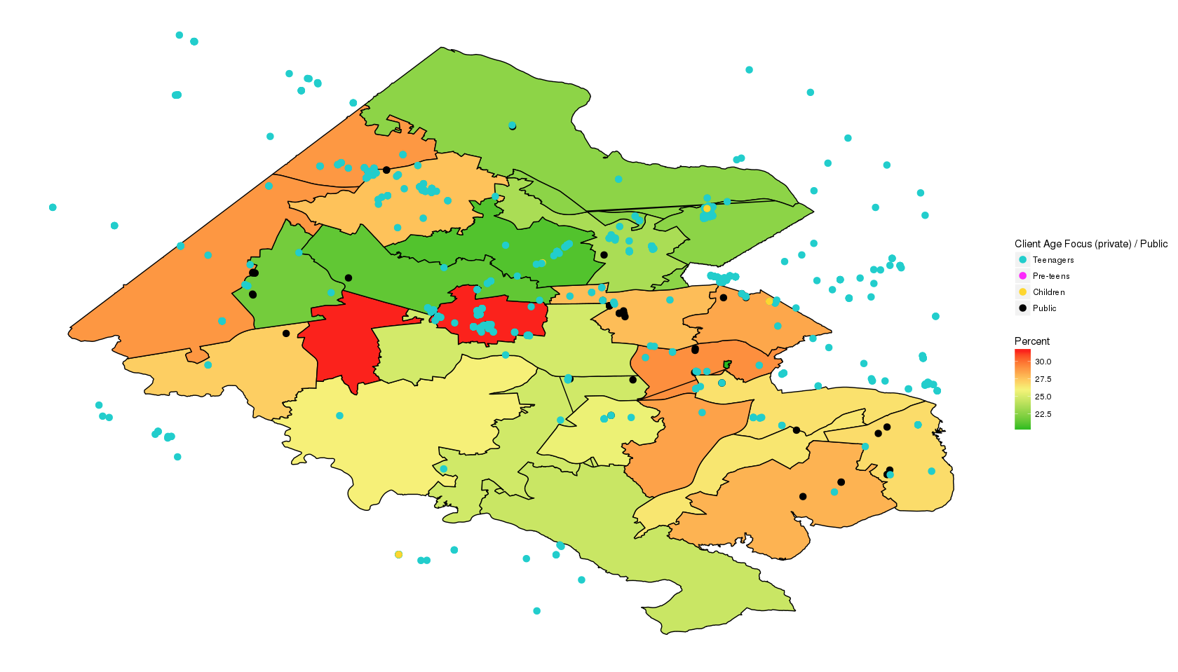
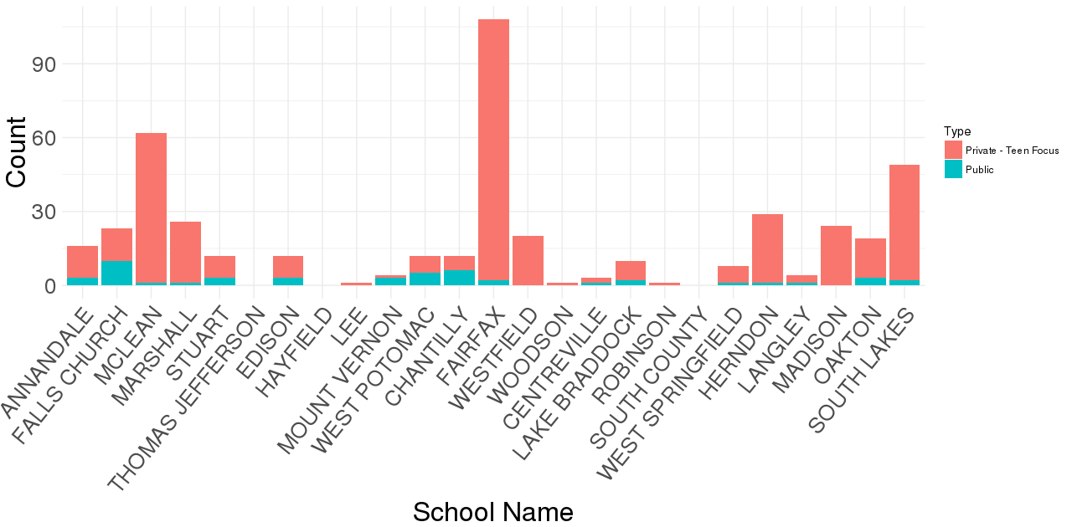
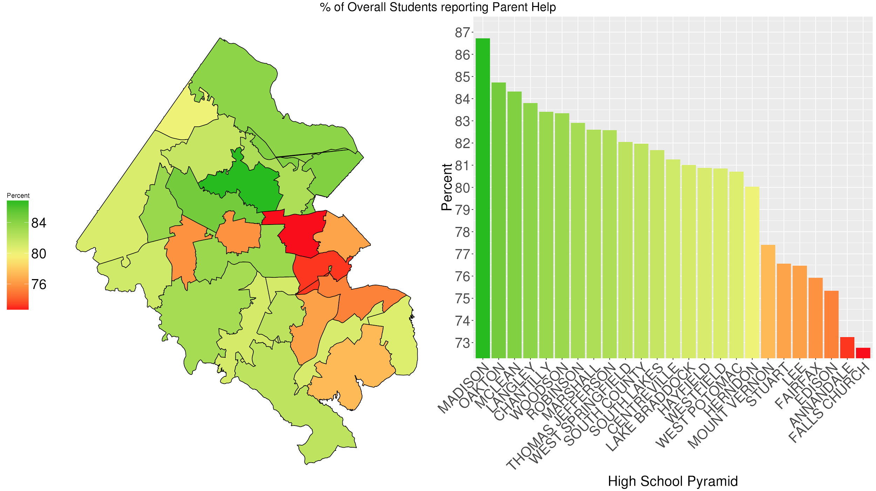
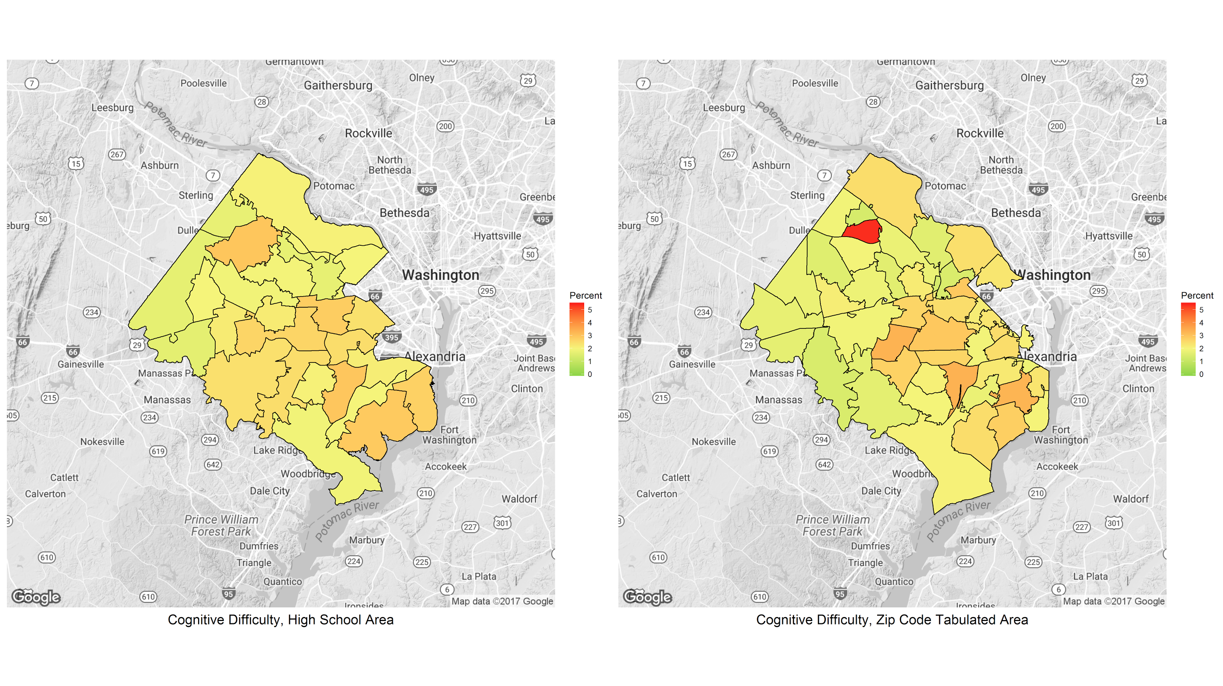

Exploring Mental Health Services for Fairfax County Youth
Zarni Htet, Chanida Lerdritsomboon, Eirik Iversen, Ben J. Swartz
with Joshua Goldstein, Stephanie Shipp, and Vicki Lancaster (SDAL)
Partner: Fairfax Health and Human Services (HHS) - Michelle Gregory,
Sophia Dutton, and Linda Hoffman
Project Description
Data Exploration of Fairfax Youth Survey 2014-2015¹
Fairfax Health and Human Services (HHS) is interested in developing long-term population and economic forecasting capabilities, in the context of specific topics (e.g., mental health services/accessibility)
Research Questions
Are mental health services accessible to address depression and anxiety for Fairfax County youth?
Are mental health services available?
Average % of Students Reporting Depressive Symptoms in each Region
Shades of green = relatively good (light) to good dark)
Red = bad; e.g., high % of students with depressive symptoms
Data Discovery & Selection
Shades of gold = in the middle from light gold (top middle) to dark gold (bottom middle)
American Community Survey (ACS)
Fairfax Community Health Dashboard
Web Scrape of Psychology Today
Fairfax Youth Survey
Substance Abuse and Mental Health Services (SAMHSA)
Virginia Department of Education (VDOE)
% of Overall Students reporting Depressive Symptoms
HERNDON 29%
Region 1
Region 5
LANGLEY 23%
SOUTH LAKES
28%
Those who felt so sad or hopeless almost everyday for two weeks or more in a row during the past 12 months
MCLEAN 23%
MADISON 21%
OAKTON 21%
CHANTILLY 22%
MARSHALL 24%
WESTFIELD 29%
FALLS CHURCH 28%
FAIRFAX 32%
STUART 28%
Region 2
WOODSON 25%
ANNANDALE 29%
CENTREVILLE 27%
THOMAS JEFFERSON 20%
WEST SPRINGFIELD 26%
ROBINSON 26%
EDISON 27%
LEE 29%
Literature Review
HAYFIELD 26%
LAKE BRADDOCK 25%
WEST POTOMAC 27%
Region 3
% of Overall Students reporting Food Insecurity
Region 4
MOUNT VERNON 28%
What is Mental Health Disorder?
A mental health disorder is: behavioral/psychological; of clinical significance, accompanied by a concomitant distress and/or a raised risk of death; or an important loss of freedom; involves an unexpected cultural response to any situation²
Service availability barriers³
Physical Location (e.g., low visibility for anonymity)
Cultural Barriers (e.g., stigma towards receiving care varies)
Administrative Barriers (e.g., hours conflict with schedule)
Mental health services provided by Fairfax County⁶
Wellness/prevention services, community based organizations, intervention programs, Medication support services, etc.
Barriers and services provided are similar to those of San Francisco and LA⁴
HERNDON 25%
Region 1
SOUTH COUNTY 25%
Region 5
LANGLEY 11%
SOUTH LAKES
23%
MCLEAN 16%
MADISON 12%
Those who go hungry because there was not enough food at home during the past 30 days
OAKTON 14%
MARSHALL 14%
WESTFIELD 21%
CHANTILLY 17%
FALLS CHURCH 33%
FAIRFAX 25%
STUART 28%
WOODSON 16%
Region 2
ANNANDALE 32%
CENTREVILLE 23%
THOMAS JEFFERSON 5%
ROBINSON 18%
EDISON 27%
WEST SPRINGFIELD
18%
LEE 28%
LAKE BRADDOCK
19%
HAYFIELD 26%
WEST POTOMAC 24%
Region 3
Region 4
MOUNT VERNON 31%
% of Overall Students reporting No Daily Physical Activity
SOUTH COUNTY 20%
LANGLEY 9%
Region 1
Region 5
HERNDON 12%
SOUTH LAKES
13%
MARSHALL 9%
MCLEAN 10%
MADISON 9%
Those physically active for less than 60 minutes during the past 7 days
CHANTILLY 9%
OAKTON 11%
FALLS CHURCH 13%
WESTFIELD 12%
FAIRFAX 12%
STUART 16%
Region 2
WOODSON 9%
ANNANDALE 14%
CENTREVILLE 11%
THOMAS JEFFERSON 16%
ROBINSON 8%
WEST SPRINGFIELD 13%
EDISON 15%
LEE 17%
HAYFIELD 13%
% of Overall Students reporting Extracurricular Regularly
LAKE BRADDOCK 11%
WEST POTOMAC 15%
Region 3
Region 4
MOUNT VERNON 19%
HERNDON 70%
Region 1
SOUTH COUNTY 10%
Region 5
LANGLEY 81%
Psychology Today Web Scrape⁷
SOUTH LAKES
72%
MARSHALL 77%
MCLEAN 79%
MADISON 80%
Those who participated in school or non-school based activities after the regular school day ended
OAKTON 83%
CHANTILLY 76%
FALLS CHURCH 63%
WESTFIELD 72%
FAIRFAX 72%
Region 2
STUART 59%
WOODSON 79%
ANNANDALE 64%
Mental Health Providers,
% of Overall Students reporting Depressive Symptoms
Count of Mental Health Service Providers by High School Pyramid
CENTREVILLE 72%
THOMAS JEFFERSON 86%
ROBINSON 75%
WEST SPRINGFIELD 75%
EDISON 62%
LEE 58%
LAKE BRADDOCK 77%
HAYFIELD 69%
WEST POTOMAC 67%
Region 2
Region 3
Region 5
Region 4
Region 1
Region 3
Region 4
MOUNT VERNON 59%
% of Overall Students reporting Parent Help
Show counts for each student focus by school boundary
SOUTH COUNTY 73%
HERNDON 80%
Region 1
Region 5
LANGLEY 84%
SOUTH LAKES
82%
MCLEAN 84%
Those who had a personal problem that could ask their parents for help
MADISON 87%
OAKTON 85%
CHANTILLY 83%
MARSHALL 83%
WESTFIELD 81%
FALLS CHURCH
73%
FAIRFAX 76%
Region 2
STUART 77%
WOODSON 83%
Client age focus is mutually exclusive so therapists are not double counted
ANNANDALE 73%
CENTREVILLE 81%
THOMAS JEFFERSON 83%
WEST SPRINGFIELD 82%
ROBINSON 83%
EDISON 75%
LEE 76%
LAKE BRADDOCK
81%
HAYFIELD 81%
WEST POTOMAC 81%
Region 3
Region 4
MOUNT VERNON 77%
Aligning ACS Data to Fairfax HS Pyramid Boundaries
SOUTH COUNTY 82%
Example of aligning one ACS variable (cognitive difficulty)
Created a synthetic population of Fairfax county and impute each individual with characteristics of the variables of interest to us (e.g., age, income, race, cognitive ability, language difficulty)
Re-computed summary statistics of those individuals by high school boundaries
Data sources: From the Census Bureau, PUMS micro data and ACS tables by zip code tabulated area (ZCTA)
Method Summary
Imputed (or sampled) a synthetic population for Fairfax using public use micro data
Imputation was used by Multivariate Imputation by Chained Equations (MICE)⁸
Specified a distribution for each variable of interest conditional on the others
Reweighted the synthetic person data according to ACS tables to match the distribution of age, income, etc. in each zip code tabulated area.
Computed summaries by high school boundaries
Next Steps
References
Fit a simple model using the Fairfax County Survey data
Find walkability scores for neighborhoods in the 25 HS pyramid boundaries to determine if mental health providers are accessible
Create a full predictive model if we can obtain FCPS youth survey data with geography
http://www.fairfaxcounty.gov/demogrph/youthpdf.htm
https://www.ncbi.nlm.nih.gov/pmc/articles/PMC556080/
https://www.ncbi.nlm.nih.gov/pubmed/24898523
https://sfwellness.org/our-program/results-impact/
http://achieve.lausd.net/smh
http://www.fairfaxcounty.gov/living/healthhuman/reports/youth-behavioral-health-service-report.pdf
https://www.psychologytoday.com/
Buuren, Stef, and Karin Groothuis-Oudshoorn. "mice: Multivariate imputation by chained equations in R." Journal of statistical software 45.3 (2011).

